Slide 1

Introduction to Web Technology(16cs302)
Mrs.M.Bhargavi
Assistant Professor
EDepartment of CSE

Slide 2

Web Technology?
Web technology refers to the way the computers communicate with each other using markup language.
It is the communication across the web,create and deliver or manage web content using hypertext markup language

Slide 3

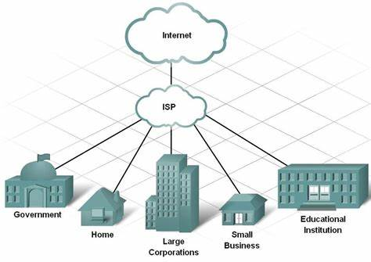
Internet:
The Internet is a global network that connects billions of computers all over the world
It is a network of networks
It links different organizations,institutions,gov offices,home users to share info among large group of users
Internet service provider
An Internet service provider (ISP) is a company that provides web access to both businesses and consumers.
ISPs may also provide other services such as email services, domain registration, web hosting, and browser services.

Slide 4

WWW
WWW: World Wide Web, which is also known as a Web, is a collection of websites or web pages stored in web servers and connected to local computers through the internet.

Slide 5
Web Page:
A web page or webpage is a document commonly written in HyperText Markup Language (HTML) that is accessible through the Internet
Website:
A Web site is a related collection of World Wide Web
Home Page:
The home page is the first Web page that is displayed after starting a Web browser
Browser:
software used to browse webpage
URL:
also called as links used to locate the websites

Slide 6
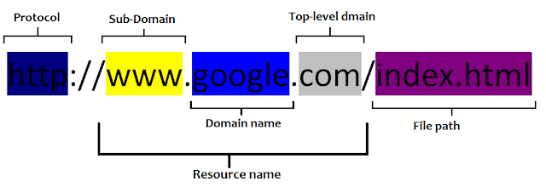
The documents and other web resources are identified by Uniform Resource Locators.
URL:A URL is a type of uniform resource identifier and is address of a resource on the World Wide Web and the protocol used to access it. It is used to indicate the location of a web resource to access the web pages.

Slide 7
The Protocol
The first part, http://, is known as the Protocol. The protocol tells the server what type of file is being requested. HTTP stands for HyperText Transfer Protocol and it is primarily used for requesting HTML (HyperText Markup Language) files.
The Sub-domain
In this example, the www is the sub-domain
In the simplest sense, it is a folder that your web content is located in
The Domain name
This is the name that the browser uses to check with the web server whether this site exists or not.
Top-level Domains
This is the name server that your browser will use to resolve the location of the requested site. Most common TLDs are .com, .org, .net etc.
The file path Since a URL is a request for a specific file, whether a static web page or a video, it should also specify the path on the server to the file needed.

Slide 8
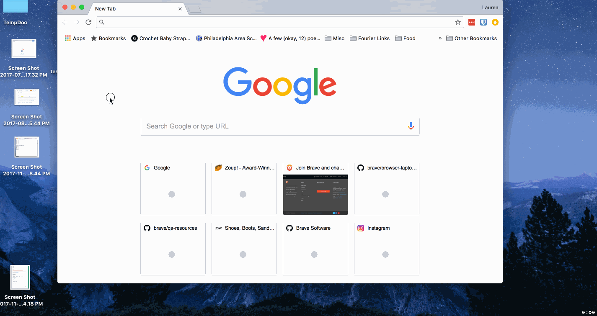

Web Page
Web page is a web document which is written in html

Slide 9
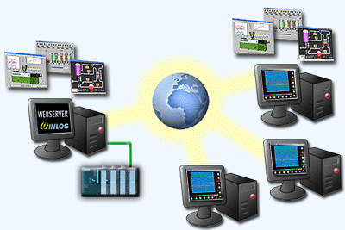
WWW:World WIDE WEB

Slide 10

Web site

Slide 11
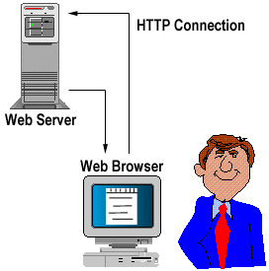
Web server and Web browser
Web Server: A special high end system that hosts a website on the internet
Web Browser: It is an application for accessing the worls wide web.

Slide 12
Course Description and Objectives:
This course offers the basic concepts used to develop static web pages and it also provides knowledge of Internet programming concepts
The objective of this course is to build web applications using client side scripting languages and server side script languages

Slide 13
Course Outcomes:
CO1: Develop a dynamic webpage using Java script and DHTML.
CO2: connect a Java program to a DBMS and perform operations on DBMS table.
CO3: server side Java application using Servlet to catch form data sent from client, process it and store it in the database.
CO4: server side Java application using JSP to catch form data sent from client and store it in the database

Slide 14
THANK YOU

Slide 15
UNIT-1
Introduction to HTML and Java Script
Mrs.M.Bhargavi
Assistant Professor
Department of CSE

Slide 16
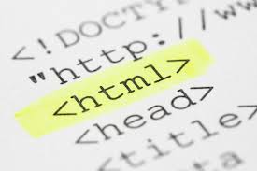
CONTENTS
HTML
HTML Common tags
CSS
Cascading style sheets
Java Script
Introduction to Java script
Lists
Tables
Images
Block level and inline Elements
Frames
Forms
CSS Properties
Objects in Java script,
Dynamic HTML with Java script.

Slide 17
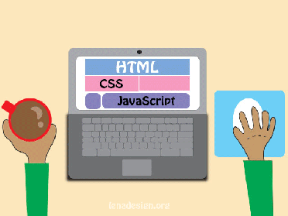
Objectives
HTML
Understand and create simple html pages
CSS
Understand and apply different styles to html pages
JS
Apply dynamic behavior to static web pages

Slide 18
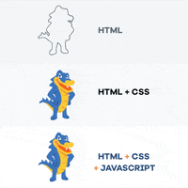

HTML,CSS and JS

Slide 19


Introduction
HTML stands for Hyper Text Markup Language
HTML is the standard markup language for creating Web pages
HTML describes the structure of a Web page
HTML consists of a series of elements
HTML elements tell the browser how to display the content

Slide 20
Hyper Text Markup Language
Hypertext is text that links to other information. By clicking on a link in a hypertext document, a user can quickly jump to different content. Though hypertext is usually associated with Web pages
Markup Language is a programming language which is used to make text more interactive and dynamic. It can turn text into a tables, list, images, etc.
An HTML document is made of many HTML tags and each HTML tag contains different content

Slide 21
Structure of HTML document
<html>
<head>
<title>title of web page</title>
<head>
<body>
Content of the page
</body>
</html>
<html> tag indicates that this page is written using html
<title>tag contains web page title
<head>tag contains info about web
<body> tag contains the content of web page
</html> marks end of the web page

Slide 22

HTML Tags
Tag is nothing but a word declared with in angular brackets(< >).
HTML tags are like keywords which defines that how web browser will format and display the content.
HTML tags are predefined tags which are not case sensitive in nature.
HTML tags contain three main parts:
opening tag
content
closing tag.

Slide 23
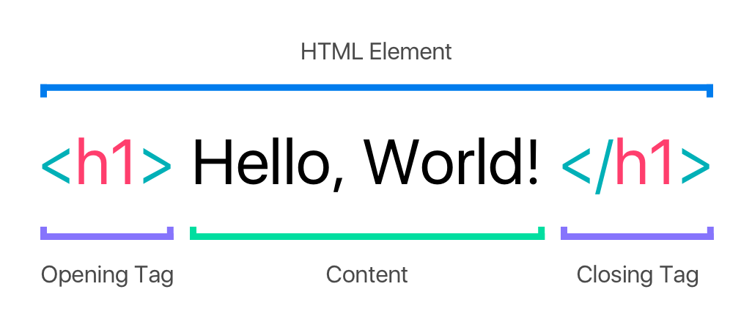

Slide 24
HTML Tags
HTML Tags
Paired Tags
Unpaired Tags
Self closing Tags

Slide 25
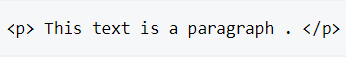
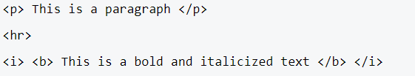
Cont..
Paired Tags:Tags consists of an opening tag and a closing tag as its companion tag.
An HTML Paired tag starts with an opening tag, which is the tag name enclosed inside the angle brackets
Example:
Unpaired Tags:Tag only has an opening tag and does not have a closing tag or a companion tag
Example:

Slide 26
Self closing Tags:Self-Closing Tags are those HTML tags that do not have a partner tag, where the first tag is the only necessary tag that is valid for the formatting.
Example:

Slide 27
HTML Text Formatting Elements
Tag | Description
<b> | Defines bold text
<em> | Defines emphasized text
<i> | Defines a part of text in an alternate voice or mood
<small> | Defines smaller text
<strong> | Defines important text
<sub> | Defines subscripted text
<sup> | Defines superscripted text
<ins> | Defines inserted text
<del> | Defines deleted text
<mark> | Defines marked/highlighted text

Slide 28
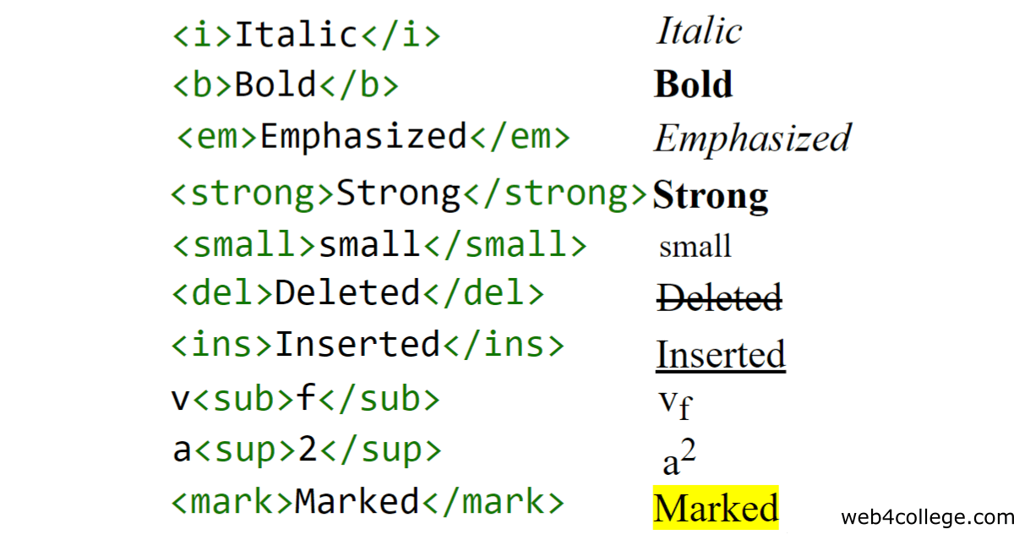
Examples

Slide 29
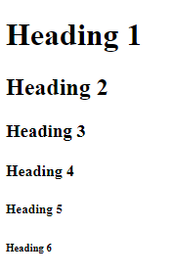
Heading Tags:
HTML headings are defined with <h1> to <h6> tags.
<h1> defines the most important heading. <h6> defines the least important heading.
<html>
<body>
<h1>Heading 1</h1>
<h2>Heading 2</h2>
<h3>Heading 3</h3>
<h4>Heading 4</h4>
<h5>Heading 5</h5>
<h6>Heading 6</h6>
</body>
</html>

Slide 30

HTML <a> Tag
The <a> tag defines a hyperlink, which is used to link from one page to another.
The most important attribute of the <a> element is the href attribute, which indicates the link's destination.
By default, links will appear as follows in all browsers:
An unvisited link is underlined and blue
A visited link is underlined and purple
An active link is underlined and red

Slide 31
Example
<html>
<body>
<h1>The a element</h1>
<a href=“F:\New folder">Anchor Tag</a>
</body>
</html>
The a element
Anchor tag

Slide 32
Cont..
target Attribute
This attribute is used to specify the location where linked document is opened.
Option Description
_blank Opens the linked document in a new window or tab.
_self Opens the linked document in the
same frame

Slide 33
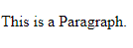
Font Tag:
It is used to change style of specific text
<font face=“verdana” size=“20” color=“blue”>Web Technologies </font>
P Tag:
The <p> element defines a paragraph
<p>This is a Paragraph</p>

Slide 34
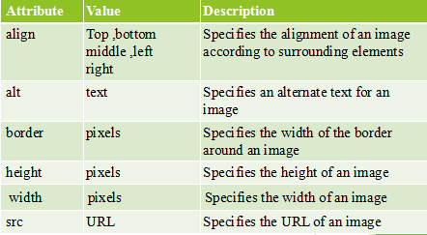
<img> Tag
The HTML <img> tag is used to put an image in an HTML document
<img src="Image URL« ... attributes-list/>

Slide 35

Example
<html>
<body>
<img src="rose.jpg" style="width:420px;height:420px;border:0;">
</body>
</html>

Slide 36
List Tags
HTML lists allow web developers to group a set of related items in lists
HTML supports 3 types of lists
unordered
Ordered
definition lists

Slide 37
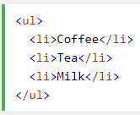
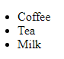
1.Unordered list
An unordered list is a collection of related items that have no special order or sequence.
Each item in the list is marked with a bullet.
This list is created by using HTML <ul> tag.
An unordered list starts with the <ul> tag. Each list item starts with the <li> tag.
<ul type=“circle|disc|compact”>

Slide 38
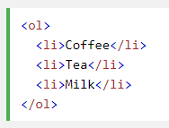
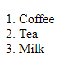
2.Ordered list
An ordered list is a collection of related items that have special order or sequence.
You can use type attribute for <ol> tag to specify the type of sequence you like. By default it is a numeric.

Slide 39
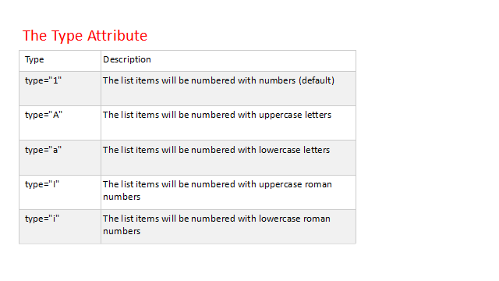

Slide 40
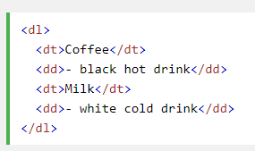
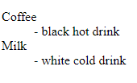
3. Definition Lists
A definition list is not a list of single items.
It is a list of items (terms), with a description of each item (term).
A definition list starts with a <dl> tag (definition list).
Each term starts with a <dt> tag (definition term).
Each description starts with a <dd> tag (definition description).

Slide 41
HTML Frames
HTML frames are used to divide your browser window into multiple sections where each section can load a separate HTML document.
A collection of frames in the browser window is known as a frameset.
The window is divided into frames.
<frameset> tag used to divide the window into frames.
The rows attribute of <frameset> tag defines horizontal frames and cols attribute defines vertical frames.
Each frame is indicated by <frame> tag and it defines which HTML document shall open into the frame.

Slide 42
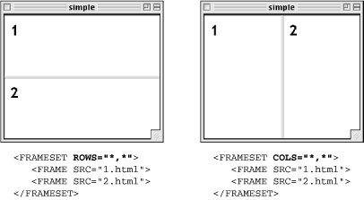
Syntax:
<frameset [cols=“%,%”] [rows=“%,%”]> ……</frameset>
To fill the data in frames
<frame src=“filename”>

Slide 43
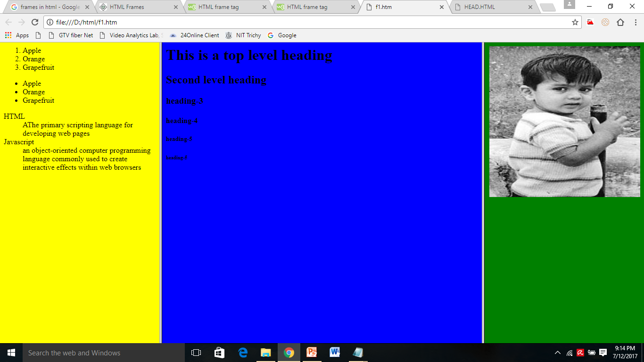

Slide 44
Example:
<html>
<frameset cols="25%,*,25%">
<frame src="list.html">
<frame src="head.html">
<frame src="img.html">
</frameset>
</html>

